Slide 1
SANISETTY AHALYA
Final Project
3/21/2024 Annual Review

Slide 2
PROJECT TITLE
KEY LOGGER AND SECURITY
3/21/2024 Annual Review

Slide 3


AGENDA
S.NO | TOPICS
1 | INTRODUCTION TO KEYLOGGERS
2 | PROBLEM STATEMENT
3 | PROJECT OVERVIEW
4 | WHO ARE THE END USERS
5 | YOUR SOLUTION AND ITS VALUE PROPOSITION
6 | THE WOW IN YOUR SOLUTION
7 | MODELLING
8 | RESULTS
3/21/2024 Annual Review

Slide 4
INTRODUCTION TO KEYLOGGERS
A keylogger or keystroke logger/keyboard capturing is a form of malware or hardware that keeps track of and records our keystrokes as we type. It takes the information and sends it to a hacker using a command-and-control (C&C) server. The hacker then analyzes the keystrokes to locate usernames and passwords and uses them to hack into otherwise secure systems.
Types of Keyloggers
SOFTWARE KEYLOGGER
Software keyloggers consist of applications that have to be installed on a computer to steal keystroke data. They are the most common method hackers use to access a user’s keystrokes.
A software keylogger is put on a computer when the user downloads an infected application. Once installed, the keylogger monitors the keystrokes on the operating system you are using, checking the paths each keystroke goes through. In this way, a software keylogger can keep track of your keystrokes and record each one.

Slide 5
HARDWARE KEYLOGGERS
A hardware keylogger works much like its software counterpart. The biggest difference is hardware keyloggers have to be physically connected to the target computer to record the user's keystrokes. For this reason, it is important for an organization to carefully monitor who has access to the network and the devices connected to it.
If an unauthorized individual is allowed to use a device on the network, they could install a hardware keylogger that may run undetected until it has already collected sensitive information. After hardware keystroke loggers have finished keylogging, they store the data, which the hacker has to download from the device.

Slide 6

PROBLEM STATEMENT
Key logging technology, while beneficial for legitimate purposes such as monitoring user behavior, troubleshooting, and ensuring compliance with organizational policies, poses significant security risks. Unauthorized key logging can lead to severe privacy violations, data breaches, and other malicious activities. Organizations and individuals need a balanced solution that leverages the advantages of key logging while mitigating the associated security risks.
Problem Description:
Legitimate Use vs. Malicious Use
Lack of Secure Key Logging Solutions
Detection and Prevention of Unauthorized Key Loggers
Ethical and Legal Compliance
3/21/2024 Annual Review

Slide 7

PROJECT OVERVIEW
The "Key Logger and Security" project aims to develop a comprehensive software solution that includes both a key logging mechanism and robust security features to prevent unauthorized key logging. The project will serve two primary purposes: monitoring and enhancing system security. Key logging, when used ethically, can help in understanding user behavior, troubleshooting, and ensuring compliance with organizational policies. However, it also poses significant security risks, necessitating effective countermeasures to detect and prevent malicious key logging activities.
Unauthorized use of keyloggers can lead to severe legal consequences.
Objectives
Key Logger Development
Security Mechanisms
Ethical and Legal Compliance
User Interface and Experience
3/21/2024 Annual Review

Slide 8

WHO ARE THE END USERS? Corporate Organizations Educational Institutions Government Agencies HealthCare Institutions Financial Institutions Parents and Guardians Small Business Owners Software Developers and Researchers Legal and Forensic Experts Individuals (for Personal Use)
3/21/2024 Annual Review

Slide 9

YOUR VALUE AND ITS PROPORTION: 1.Secure Key Logger: Accurate Keystroke Logging: Captures keystrokes accurately across various applications and environments. Secure Data Storage: Encrypts logged data to prevent unauthorized access. 2. Detection and Prevention Tools: Unauthorized Key Logger Detection: Scans for and identifies unauthorized key logging software on systems. Real-Time Alerts: Provides real-time notifications of suspicious activities. 3. Enhanced Security: Proactive Threat Detection: Advanced tools to detect and neutralize unauthorized key loggers, protecting sensitive data from malicious activities. Data Protection: Secure encryption and storage of logged data, ensuring it is protected from unauthorized access and breaches.
3/21/2024 Annual Review

Slide 10

THE WOW IN YOUR SOLUTION
Multi-Layered Defense: The solution doesn't rely on a single security measure but combines multiple layers of defense, including antivirus software, firewalls, encryption, user education, access controls, and behavioral analysis. This multi-layered approach increases the effectiveness of the overall security posture.
Proactive Protection: Rather than merely reacting to security incidents after they occur, the solution emphasizes proactive measures such as regular software updates, patch management, and user awareness training. By staying ahead of potential threats, organizations can reduce the likelihood and impact of security breaches.
3/21/2024 Annual Review
10

Slide 11
MODELLING
IMPORT MODULES: Importing modules and libraries such as tkinter,pynput,json.
SETTING UP LOGGING: Configure logging settings to specify the format and destination of log and json files.
DEFINING KEYLOGGER FUNCTIONS: Creating function to capture and log keystrokes.
MAIN FUNCTION: This function is used to start the keylogger and keep it run indefinitely until user stops.
TESTING: Test the keylogger whether it captures keystrokes correctly or not.
DEPLOYMENT: Deploy the keylogger on target systems if necessary under legal and ethical considerations.
3/21/2024 Annual Review
11

Slide 12
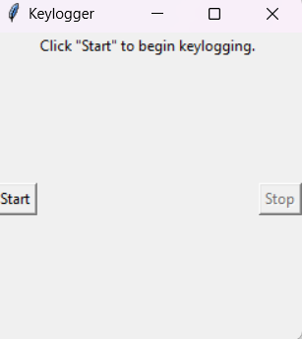
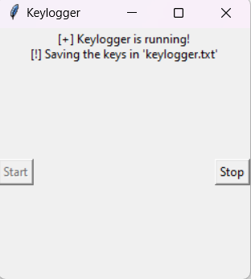
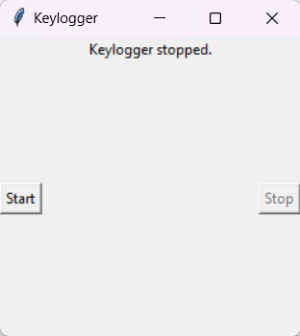

RESULTS
3/21/2024 Annual Review
12

Slide 13
Project link https://github.com/sanisettyahalya/ahalya.git

